Slide 1

Cryptography
Dr. Tran The Son
Notes:
Lecture slides prepared for “Cryptography and Network Security”, 6/e, by William Stallings, Chapter 4 – “Basic Concepts in Number Theory and Finite Fields”.

Slide 2
Chapter 2
Introduction to Number Theory
Notes:
Finite fields have become increasingly important in cryptography. A number of cryptographic
algorithms rely heavily on properties of finite fields, notably the Advanced
Encryption Standard (AES) and elliptic curve cryptography. Other examples include
the message authentication code CMAC and the authenticated encryption
scheme GCM.
This chapter provides the reader with sufficient background on the concepts of
finite fields to be able to understand the design of AES and other cryptographic algorithms
that use finite fields. The first three sections introduce basic concepts from number
theory that are needed in the remainder of the chapter; these include divisibility,
the Euclidian algorithm, and modular arithmetic. Next comes a brief overview of the
concepts of group, ring, and field. This section is somewhat abstract; the reader may
prefer to quickly skim this section on a first reading. We are then ready to discuss finite
fields of the form GF(p ), where p is a prime number. Next, we need some additional
background, this time in polynomial arithmetic. The chapter concludes with a discussion
of finite fields of the form GF(2^{n} ), where n is a positive integer.

Slide 3
Chapter 2: Outline
Divisibility and The Division Algorithm Divisibility
The Euclidean Algorithm
Modular Arithmetic
Prime Numbers
Fermat’s and Euler’s Theorems
Testing for Primality
The Chinese Remainder Theorem
Discrete Logarithms

Slide 4
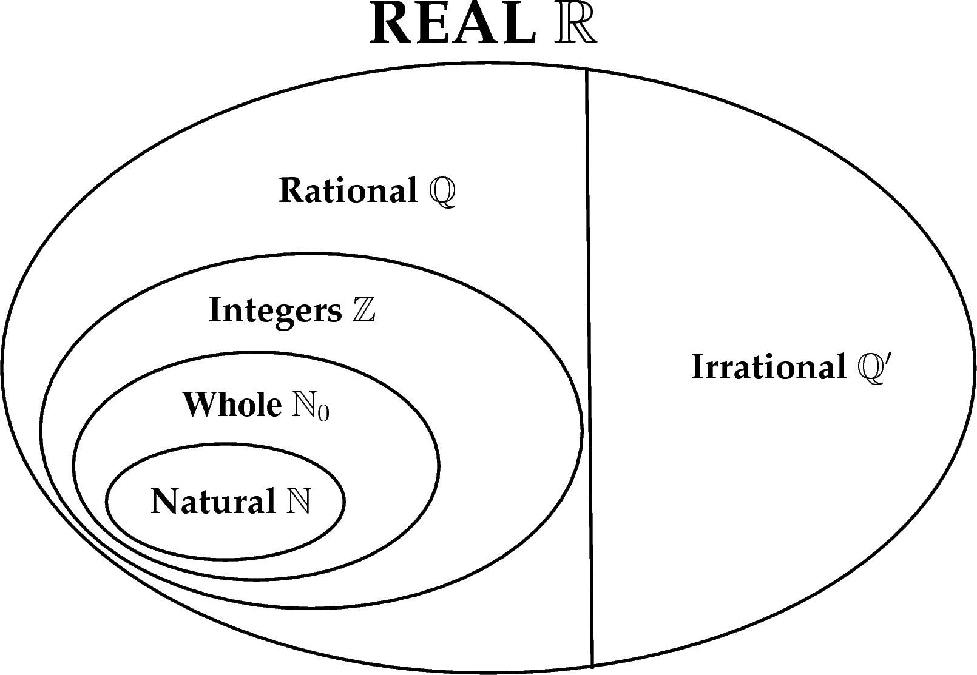
Introduction

Slide 5
Divisibility
We say that a nonzero b divides a if a = mb for some m, where a, b, and m are integers
b divides a if there is no remainder on division
The notation b | a is commonly used to mean b divides a
If b | a we say that b is a divisor of a
The positive divisors of 24 are 1, 2, 3, 4, 6, 8, 12, and 24
13 | 182; - 5 | 30; 17 | 289; - 3 | 33; 17 | 0
Notes:
We say that a nonzero b divides a if a=mb for some m, where a, b, and m are integers. That is, b divides a if there is no remainder on division.
The notation b | a is commonly used to mean b divides a . Also, if b | a , we say that b is a divisor of a .

Slide 6
Properties of Divisibility
If a | 1, then a = ±1
If a | b and b | a, then a = ±b
Any b ≠ 0 divides 0
If a | b and b | c, then a | c
If b | g and b | h, then b | (mg + nh) for arbitrary integers m and n
11 | 66 and 66 | 198 = 11 | 198
Notes:
Subsequently, we will need some simple properties of divisibility for integers, which are as follows:
• If a|1, then a = ±1.
• If a|b and b|a, then a = ±b.
• Any b ≠ 0 divides 0.
• If a | b and b | c, then a | c
• If b|g and b|h, then b|(mg + nh) for arbitrary integers m and n.

Slide 7
Properties of Divisibility
To see this last point, note that:
  If b | g , then g is of the form g = b * g₁ for some integer g₁
  If b | h , then h is of the form h = b * h₁ for some integer h₁
So:
  mg + nh = mbg₁ + nbh₁ = b * (mg₁ + nh₁ )
  and therefore b divides mg + nh
b = 7; g = 14; h = 63; m = 3; n = 2
7 | 14 and 7 | 63.
To show 7 (3 * 14 + 2 * 63),
we have (3 * 14 + 2 * 63) = 7(3 * 2 + 2 * 9),
and it is obvious that 7 | (7(3 * 2 + 2 * 9)).
Notes:
To see this last point, note that
• If b | g , then g is of the form g = b * g₁ for some integer g₁ .
• If b | h , then h is of the form h = b * h₁ for some integer h₁ .
So
mg + nh = mbg₁ + nbh₁ = b * (mg₁ + nh₁ )
and therefore b divides mg + nh .

Slide 8
Division Algorithm
Given any positive integer n and any nonnegative integer a, if we divide a by n we get an integer quotient q and an integer remainder r that obey the following relationship:
  a = qn + r |r |< |n|; q = ⎣a/n⎦
Notes:
Given any positive integer n and any nonnegative integer a, if we divide a by n, we get an integer quotient q and an integer remainder r that obey the following relationship:
a = qn + r, 0 ≤ r < n; q = [a/n] which is referred to as the division algorithm.

Slide 9
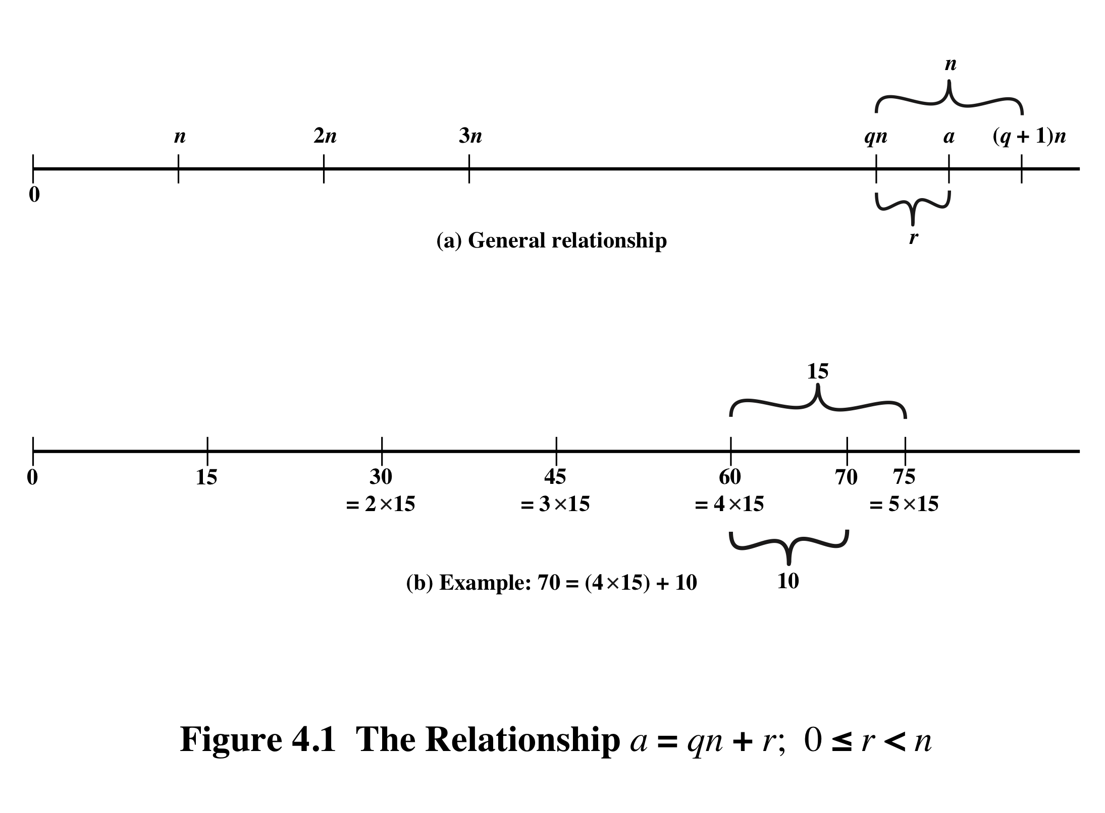
Notes:
Figure 4.1a demonstrates that, given a and positive n, it is always possible to find q and r that satisfy the preceding relationship. Represent the integers on the number line; a will fall somewhere on that line (positive a is shown, a similar demonstration can be made for negative a). Starting at 0, proceed to n, 2n, up to qn such that qn ≤ a and (q + 1)n > a. The distance from qn to a is r, and we have found the unique values of q and r. The remainder r is often referred to as a residue .
For example:
a = 11; n = 7; 11 = 1 x 7 + 4; r = 4 q = 1
a = –11; n = 7; –11 = (–2) x 7 + 3; r = 3 q = –2
Figure 4.1b provides another example.

Slide 10
Euclidean Algorithm
One of the basic techniques of number theory
Procedure for determining the greatest common divisor of two positive integers
Two integers are relatively prime (aka coprime) if their only common positive integer factor is 1
Notes:
One of the basic techniques of number theory is the Euclidean algorithm, which
is a simple procedure for determining the greatest common divisor of two positive
integers. First, we need a simple definition: Two integers are relatively prime if their
only common positive integer factor is 1.

Slide 11
Greatest Common Divisor (GCD)
The greatest common divisor of a and b is the largest integer that divides both a and b
We can use the notation gcd(a,b) to mean the greatest common divisor of a and b
We also define gcd(0,0) = 0
Positive integer c is said to be the gcd of a and b if:
  c is a divisor of a and b
  Any divisor of a and b is a divisor of c
  An equivalent definition is:
  gcd(a,b) = max[k, such that k | a and k | b]
Notes:
Recall that nonzero b is defined to be a divisor of a if a = mb for some m , where a , b , and
m are integers. We will use the notation gcd(a , b ) to mean the greatest common divisor
of a and b . The greatest common divisor of a and b is the largest integer that divides
both a and b . We also define gcd(0, 0) = 0.
More formally, the positive integer c is said to be the greatest common divisor
of a and b if
1. c is a divisor of a and of b .
2. Any divisor of a and b is a divisor of c .
An equivalent definition is the following:
gcd(a , b ) = max[k , such that k | a and k | b ]

Slide 12
GCD
Because we require that the greatest common divisor be positive, gcd(a,b) = gcd(a,-b) = gcd(-a,b) = gcd(-a,-b)
In general, gcd(a,b) = gcd(| a |, | b |)
Also, because all nonzero integers divide 0, we have gcd(a,0) = | a |
We stated that two integers a and b are relatively prime if their only common positive integer factor is 1; this is equivalent to saying that a and b are relatively prime if gcd(a,b) = 1
gcd(60, 24) = gcd(60, - 24) = 12
8 and 15 are relatively prime because the positive divisors of 8 are 1, 2, 4, and 8, and the positive divisors of 15 are 1, 3, 5, and 15. So 1 is the only integer on both lists.
Notes:
Because we require that the greatest common divisor be positive, gcd(a , b ) =
gcd(a , -b ) = gcd(-a , b ) = gcd(-a ,-b ). In general, gcd(a , b ) = gcd( | a | , | b | ).
Also, because all nonzero integers divide 0, we have gcd(a , 0) = a .
We stated that two integers a and b are relatively prime if their only common
positive integer factor is 1. This is equivalent to saying that a and b are relatively
prime if gcd(a , b ) = 1.

Slide 13
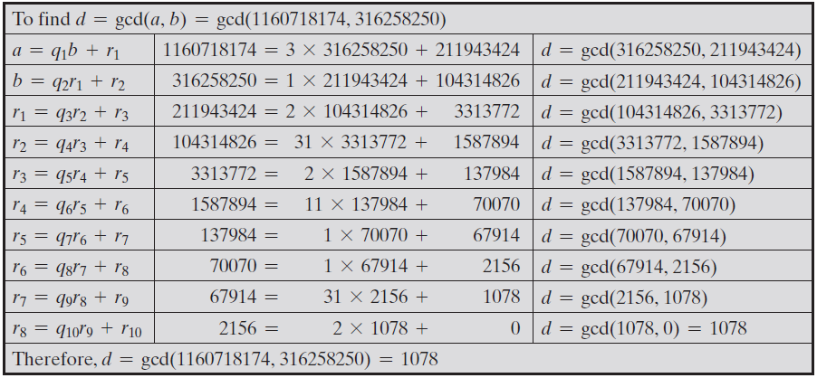
Table 4.1
Euclidean Algorithm Example
gcd(a, b) = gcd(b, a mod b)
Notes:
In this example, we begin by dividing 1160718174 by 316258250, which gives 3
with a remainder of 211943424. Next we take 316258250 and divide it by 211943424.
The process continues until we get a remainder of 0, yielding a result of 1078.

Slide 14
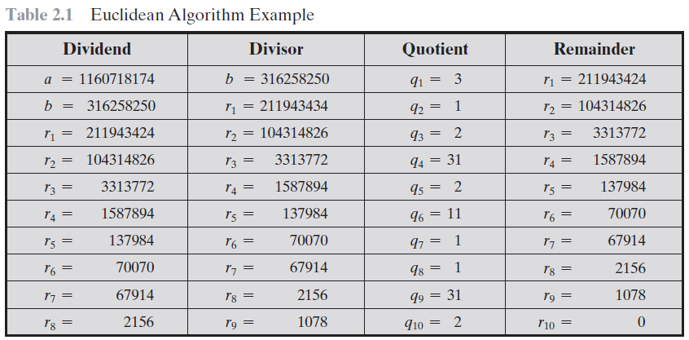

Slide 15
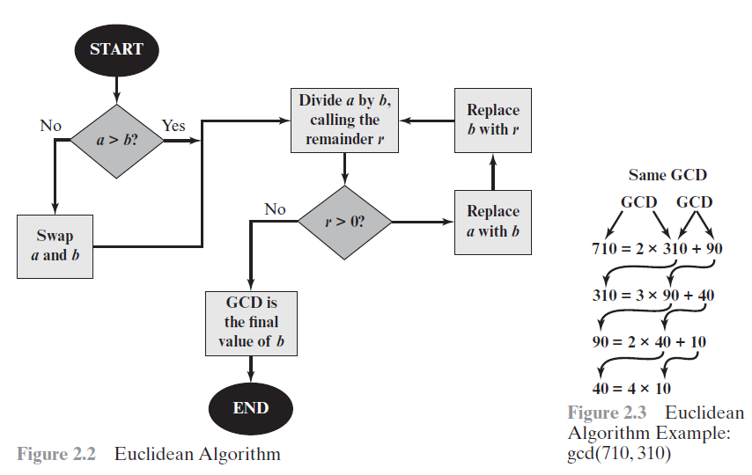
Euclidean Algorithm

Slide 16
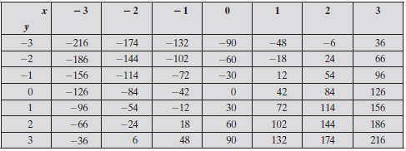
The Extended Euclidean Algorithm
For given integers a and b, the extended Euclidean algorithm not only calculates the greatest common divisor d but also two additional integers x and y that satisfy the following equation.
Eg a = 42, b = 30
ax + by = d = gcd(a, b)

Slide 17
Exercise
Determine gcd(72345, 43215)
Determine gcd(3486, 10292)

Slide 18
Modular Arithmetic
The modulus
  If a is an integer and n is a positive integer, we define a mod n to be the remainder when a is divided by n; the integer n is called the modulus
  thus, for any integer a:
  a = qn + r | r | < |n|; q = ⎣a/ n⎦
  a = ⎣a/ n⎦ * n + ( a mod n)
11 mod 7 = 4; - 11 mod 7 = 3
Notes:
If a is an integer and n is a positive integer, we define a mod n to be the remainder
when a is divided by n . The integer n is called the modulus . Thus, for any integer a:
a = qn + r 0 ≤ r < n; q = [ a/ n]
a = [a/ n] * n + ( a mod n)

Slide 19
Exercise
-1 mod 5
-11 mod 7
23 mod 21
23 mod -21

Slide 20
Modular Arithmetic
Congruent modulo n
  Two integers a and b are said to be congruent modulo n if (a mod n) = (b mod n)
  This is written as a ≡ b (mod n)
  Note that if a ≡ 0 (mod n), then n | a
73 = 4 (mod 23); 21 = - 9 (mod 10)
Notes:
Two integers a and b are said to be congruent modulo n , if (a mod n ) =
(b mod n ). This is written as a K b (mod n ).²
Note that if a = 0 (mod n ), then n | a .

Slide 21
Properties of Congruences
Congruences have the following properties:
1. a ≡ b (mod n) if n|(a – b)
2. a ≡ b (mod n) implies b ≡ a (mod n)
3. a ≡ b (mod n) and b ≡ c (mod n) imply a ≡ c (mod n)
To demonstrate the first point, if n (a - b), then (a - b) = kn for some k
  So we can write a = b + kn
  Therefore, (a mod n) = (remainder when b + kn is divided by n) = (remainder when b is divided by n) = (b mod n)
23 = 8 (mod 5) because 23 - 8 = 15 = 5 * 3
- 11 = 5 (mod 8) because - 11 - 5 = - 16 = 8 * (- 2)
81 = 0 (mod 27) because 81 - 0 = 81 = 27 * 3
Notes:
Congruences have the following properties:
1. a = b (mod n) if n (a – b)
2. a = b (mod n) implies b = a (mod n)
3. a = b (mod n) and b = c (mod n) imply a = c (mod n)
To demonstrate the first point, if n (a - b), then (a - b) = kn for some k
So we can write a = b + kn
Therefore, (a mod n) = (remainder when b + kn is divided by n) = (remainder when b is divided by n) = (b mod n)

Slide 22
Modular Arithmetic
Modular arithmetic exhibits the following properties:
1. [(a mod n) + (b mod n)] mod n = (a + b) mod n
2. [(a mod n) - (b mod n)] mod n = (a - b) mod n
3. [(a mod n) * (b mod n)] mod n = (a * b) mod n
We demonstrate the first property:
  Define (a mod n) = r_{a} and (b mod n) = r_{b}. Then we can write a = r_{a} + jn for some integer j and b = r_{b} + kn for some integer k
  Then:
(a + b) mod n = (r_{a} + jn + r_{b} + kn) mod n
= (r_{a} + r_{b} + (k + j)n) mod n
= (r_{a} + r_{b}) mod n
= [(a mod n) + (b mod n)] mod n
Notes:
Modular arithmetic exhibits the following properties:
1. [(a mod n) + (b mod n)] mod n = (a + b) mod n
2. [(a mod n) - (b mod n)] mod n = (a - b) mod n
3. [(a mod n) * (b mod n)] mod n = (a * b) mod n
We demonstrate the first property:
Define (a mod n) = r_{a} and (b mod n) = r_{b}. Then we can write a = r_{a} + jn for some integer j and b = r_{b} + kn for some integer k.
Then:
(a + b) mod n = (ra + jn + rb + kn) mod n
= (ra + rb + (k + j)n) mod n
= (ra + rb) mod n
= [(a mod n) + (b mod n)] mod n

Slide 23
Exercise
4x ≡ 2 (mod 3)
7x ≡ 4 (mod 9)
5x ≡ 3 (mod 11)

Slide 24
Remaining Properties:
Examples of the three remaining properties:
11 mod 8 = 3; 15 mod 8 = 7
[(11 mod 8) + (15 mod 8)] mod 8 = 10 mod 8 = 2
(11 + 15) mod 8 = 26 mod 8 = 2
[(11 mod 8) - (15 mod 8)] mod 8 = - 4 mod 8 = 4
(11 - 15) mod 8 = - 4 mod 8 = 4
[(11 mod 8) * (15 mod 8)] mod 8 = 21 mod 8 = 5
(11 * 15) mod 8 = 165 mod 8 = 5
Notes:
The remaining properties are proven as easily. Here are examples of the three
Properties.

Slide 25
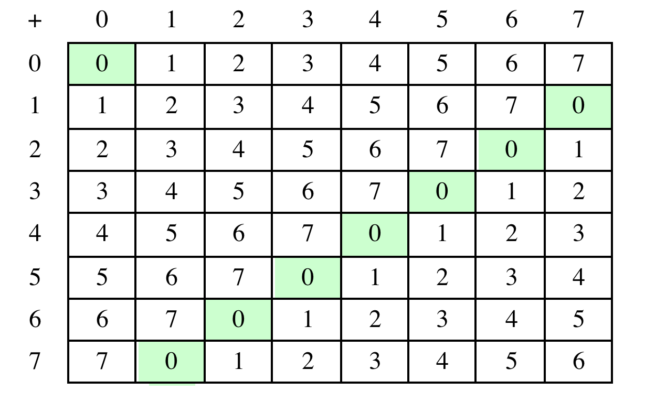
Table 4.2(a) Arithmetic Modulo 8
Notes:
Table 4.2 provides an illustration of modular addition and multiplication
modulo 8. Looking at addition, the results are straightforward, and there is a regular
pattern to the matrix. Both matrices are symmetric about the main diagonal
in conformance to the commutative property of addition and multiplication.

Slide 26
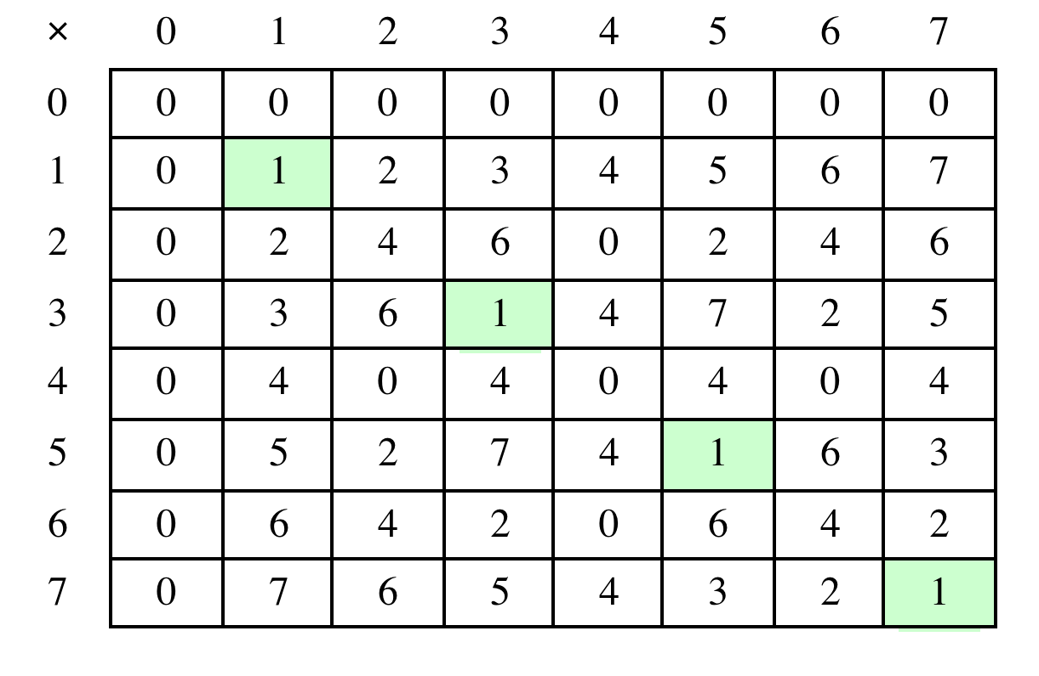
Table 4.2(b) Multiplication Modulo 8
Notes:
Similarly, the entries in the multiplication table are straightforward. In ordinary
arithmetic, there is a multiplicative inverse, or reciprocal, to each integer. In modular
arithmetic mod 8, the multiplicative inverse of x is the integer y such that
(x * y ) mod 8 = 1 mod 8. Now, to find the multiplicative inverse of an integer
from the multiplication table, scan across the matrix in the row for that integer to
find the value 1; the integer at the top of that column is the multiplicative inverse;
thus, (3 * 3) mod 8 = 1. Note that not all integers mod 8 have a multiplicative
inverse; more about that later.

Slide 27
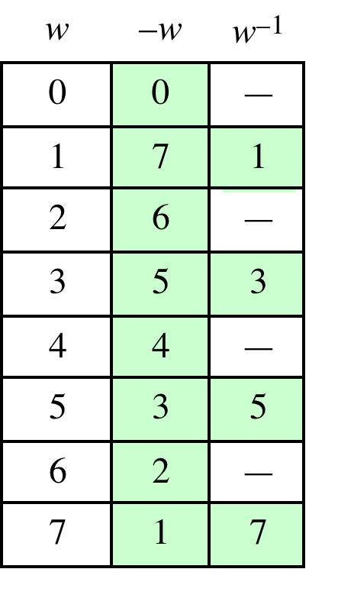
Table 4.2(c)
Additive and
Multiplicative Inverses
Modulo 8
a + x ≡ 0 mod m
w * w⁻¹ ≡ 1 mod m
Notes:
As in ordinary addition, there is an additive inverse, or negative, to each integer in
modular arithmetic. In this case, the negative of an integer x is the integer y such
that (x + y ) mod 8 = 0. To find the additive inverse of an integer in the left-hand
column, scan across the corresponding row of the matrix to find the value 0; the
integer at the top of that column is the additive inverse; thus, (2 + 6) mod 8 = 0.

Slide 28
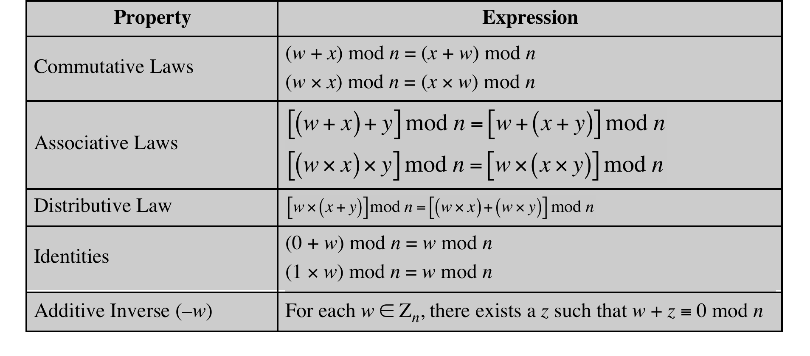
Table 4.3
Properties of Modular Arithmetic for Integers in Z_{n}
Notes:
If we perform modular arithmetic within Z_{n}, the properties shown in Table 4.3 hold for integers in Z_{n} We show in the next section that this implies that Z_{n} is a commutative ring with a multiplicative identity element. Note that unlike ordinary arithmetic, the following statement is true only with the attached condition:
if (a x b) = (a x c) (mod n) then b = c (mod n) if a is relatively prime to n
In general, an integer has a multiplicative inverse in Z_{n} if that integer is relatively prime to n. Table 4.2 cin the text shows that the integers 1, 3, 5, and 7 have a multiplicative inverse in Z 8, but 2, 4, and 6 do not.

Slide 29
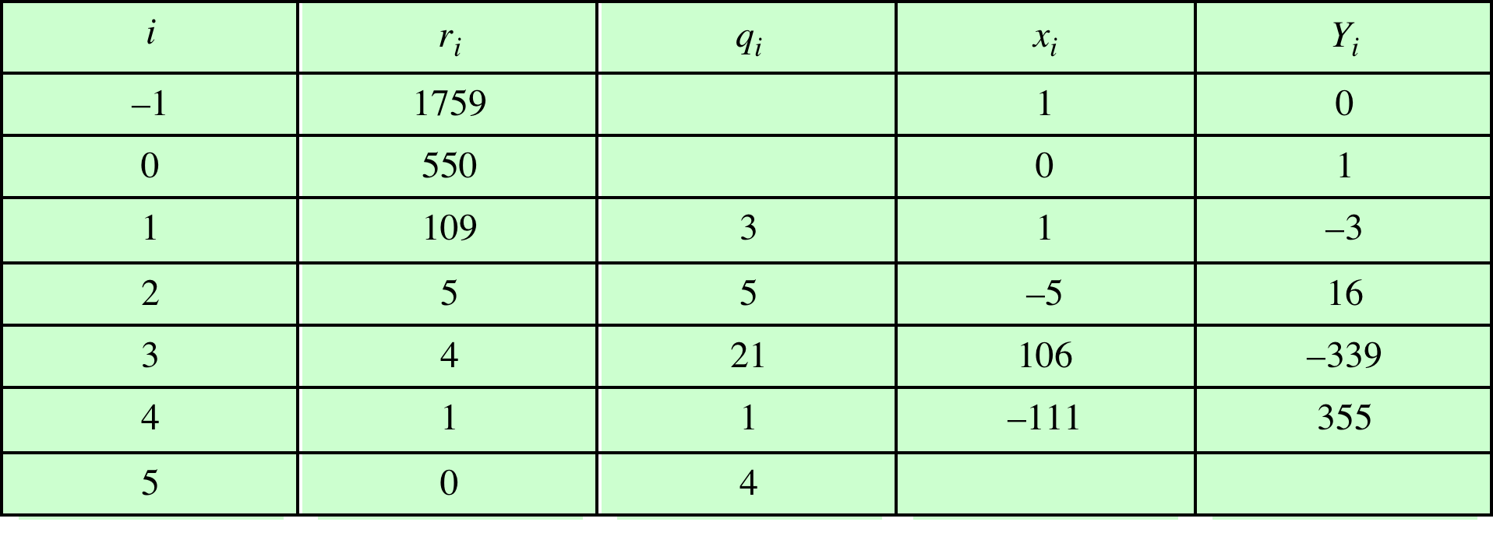
Table 4.4
Extended Euclidean Algorithm Example
For given integers a and b, find <d,x,y> satisfying: ax + by = d = gcd(a,b)
a
b
Result: d = 1; x = –111; y = 355
Notes:
Example of the Extended Euclidean Algorithm. (See pages 97 – 99 in textbook for details.)

Slide 30
Prime Numbers
Prime numbers only have divisors of 1 and itself
  They cannot be written as a product of other numbers
Prime numbers are central to number theory
Any integer a > 1 can be factored in a unique way as
a = _{p1} ^{a1} * p₂ ^{a2} * . . . * p_{p1} ^{a1}
where p₁ < p₂ < . . . < p_{t} are prime numbers and where each a_{i} is a positive integer
This is known as the fundamental theorem of arithmetic
Notes:
An integer p > 1 is a prime number if and only if its only divisors are ±1
and ± p . Prime numbers play a critical role in number theory and in the techniques
discussed in this chapter.
Any integer a > 1 can be factored in a unique way as
a = _{p1} ^{a1} * p₂ ^{a2} * . . . * p_{p1} ^{a1}
where p₁ < p₂ < . . . < p_{t} are prime numbers and where each a_{i} is a positive integer
This is known as the fundamental theorem of arithmetic

Slide 31
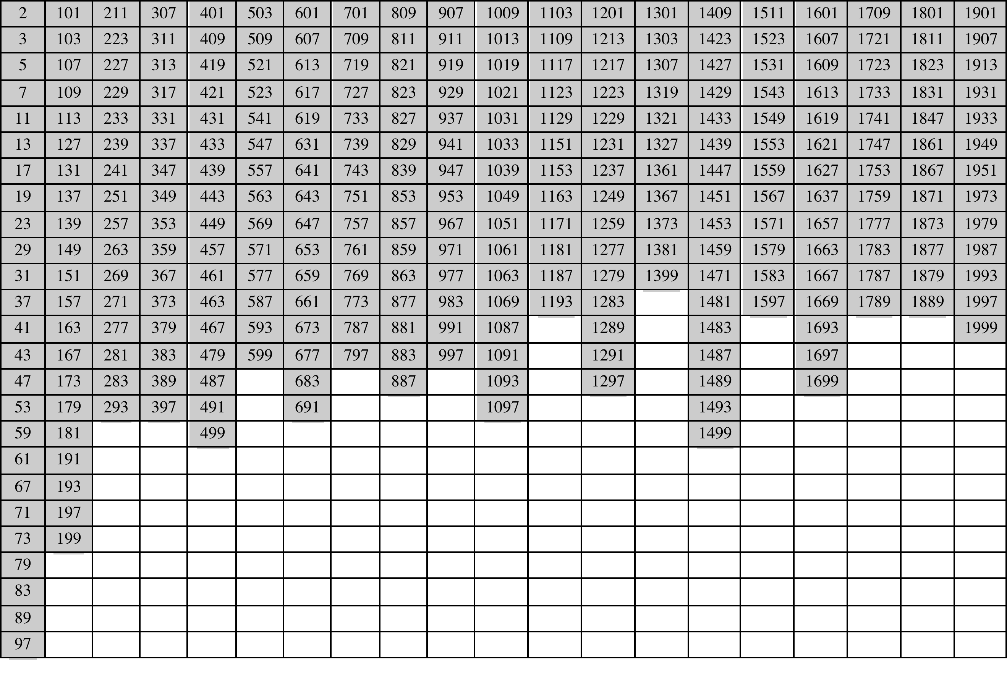
Table 8.1
Primes Under 2000
Notes:
Table 8.1 shows the primes less than 2000. Note the way
the primes are distributed. In particular, note the number of primes in each range
of 100 numbers.

Slide 32
Fermat's Theorem
States the following:
  If p is prime and a is a positive integer not divisible by p then
a^{p-1} ≡ 1 (mod p)
Sometimes referred to as Fermat’s Little Theorem
An alternate form is:
  If p is prime and a is a positive integer then
a^{p} ≡ a (mod p)
Plays an important role in public-key cryptography
Notes:
Two theorems that play important roles in public-key cryptography are Fermat’s
theorem and Euler’s theorem.
Fermat’s theorem states the following: If p is prime and a is a positive integer not
divisible by p, then
a^{p-1} = 1 (mod p)
An alternative form of Fermat’s theorem is also useful: If p is prime and a is a
positive integer, then
a^{p} = a (mod)

Slide 33
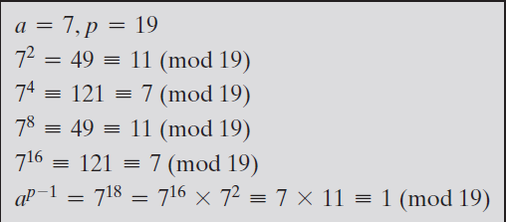
E.g.

Slide 34
Euler’s theorem
Euler’s totient function
  This function, written φ(n), is defined as the number of positive integers less than n and relatively prime to n.
      By convention, φ(1) = 1.
Two integers a and b are coprime, relatively prime or mutually prime if the only positive integer that is a divisor of both of them is 1. i.e. gcd(m,n) = 1

Slide 35
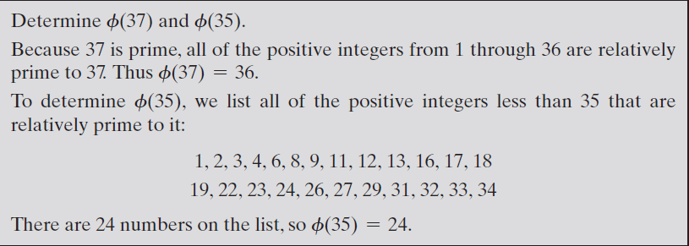
E.g

Slide 36
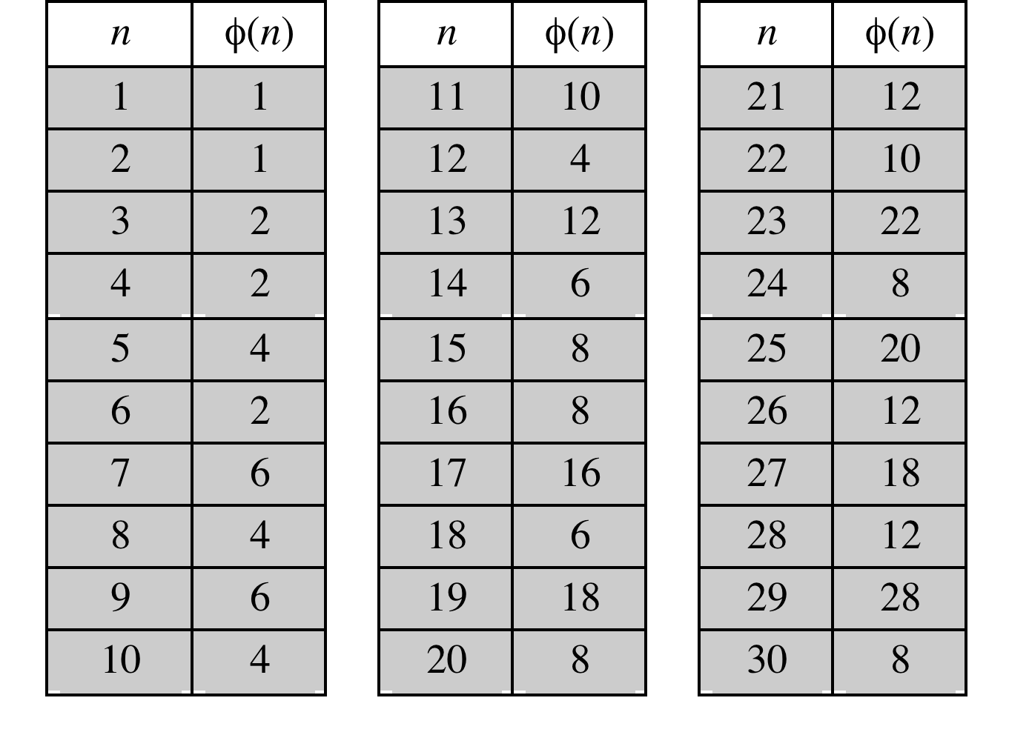
Table 8.2
Some Values of Euler’s Totient Function ø(n)
φ(n) = φ (pq) = φ (p) * φ (q) = (p - 1) * (q - 1)
Notes:
Before presenting Euler’s theorem, we need to introduce an important quantity in
number theory, referred to as Euler’s totient function, written ø (n ), and defined as
the number of positive integers less than n and relatively prime to n . By convention,
ø(1) = 1.
Table 8.2 lists the first 30 values of ø (n ). The value ø(1) is without meaning
but is defined to have the value 1.
It should be clear that, for a prime number p ,
ø (p ) = p - 1

Slide 37
Euler's Theorem
States that for every a and n that are relatively prime:
a^{ø(n)} ≡ 1(mod n)
An alternative form is:
a^{ø(n)+1} ≡ a(mod n)
Plays an important role in public-key cryptography
Notes:
Euler’s theorem states that for every a and n that are relatively prime:
a^{ø(n)} = 1(mod n)
As is the case for Fermat’s theorem, an alternative form of the theorem is also
Useful:
a^{ø(n)+1} = a(mod n)

Slide 38

Miller-Rabin Algorithm
Typically used to test a large number for primality
For any positive odd integer n ≥ 3 can be expressed as
Notes:
For many cryptographic algorithms, it is necessary to select one or more very large
prime numbers at random. Thus, we are faced with the task of determining whether
a given large number is prime. There is no simple yet efficient means of accomplishing
this task.
In this section, we present one attractive and popular algorithm. You may be
surprised to learn that this algorithm yields a number that is not necessarily a prime.
However, the algorithm can yield a number that is almost certainly a prime. This
will be explained presently. We also make reference to a deterministic algorithm
for finding primes. The section closes with a discussion concerning the distribution
of primes.
The algorithm due to Miller and Rabin [MILL75, RABI80] is typically used to test
a large number for primality.
The procedure TEST takes a candidate integer n as input and returns the result composite
if n is definitely not a prime, and the result inconclusive if n may or may not
be a prime.
How can we use the Miller-Rabin algorithm to determine with a high degree of confidence whether or not an integer
is prime? It can be shown [KNUT98] that given an odd number n that is not prime
and a randomly chosen integer, a with 1 < a < n - 1, the probability that TEST
will return inconclusive (i.e., fail to detect that n is not prime) is less than 1/4.
Thus, if t different values of a are chosen, the probability that all of them will pass
TEST (return inconclusive) for n is less than (1/4)^{t} . For example, for t = 10, the
probability that a nonprime number will pass all ten tests is less than 10⁻⁶ . Thus,
for a sufficiently large value of t, we can be confident that n is prime if Miller’s test
always returns inconclusive .
This gives us a basis for determining whether an odd integer n is prime
with a reasonable degree of confidence. The procedure is as follows: Repeatedly
invoke TEST (n) using randomly chosen values for a . If, at any point, TEST returns
composite , then n is determined to be nonprime. If TEST continues to
return inconclusive for t tests, then for a sufficiently large value of t , assume
that n is prime.

Slide 39
  TEST (n)
1.
2.
3.
4.
5.
6.
Select a random integer a, 1 < a < n – 1 ;
if a^{q} mod n = 1 then return (“inconclusive") ;
for j = 0 to k – 1 do
if (a^{2jq} mod n = n – 1) then return (“inconclusive") ;
return (“composite") ;
Find integers k, q, with k > 0, q odd, so that (n – 1)=2^{k}q ;

Slide 40
Deterministic Primality Algorithm
Prior to 2002 there was no known method of efficiently proving the primality of very large numbers
All of the algorithms in use produced a probabilistic result
In 2002 Agrawal, Kayal, and Saxena developed an algorithm that efficiently determines whether a given large number is prime
  Known as the AKS algorithm
  Does not appear to be as efficient as the Miller-Rabin algorithm
Notes:
Prior to 2002, there was no known method of efficiently proving the primality of very
large numbers. All of the algorithms in use, including the most popular (Miller-Rabin),
produced a probabilistic result. In 2002 (announced in 2002, published in 2004),
Agrawal, Kayal, and Saxena [AGRA04] developed a relatively simple deterministic
algorithm that efficiently determines whether a given large number is a prime. The algorithm,
known as the AKS algorithm, does not appear to be as efficient as the Miller-
Rabin algorithm. Thus far, it has not supplanted this older, probabilistic technique.

Slide 41
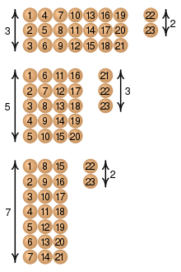
Chinese Remainder Theorem (CRT)
Believed to have been discovered by the Chinese mathematician Sun-Tsu in around 100 A.D.
One of the most useful results of number theory
Says it is possible to reconstruct integers in a certain range from their residues modulo a set of pairwise relatively prime moduli
Can be stated in several ways
Notes:
One of the most useful results of number theory is the Chinese remainder theorem
(CRT). In essence, the CRT says it is possible to reconstruct integers in a certain
range from their residues modulo a set of pairwise relatively prime moduli.
The CRT can be stated in several ways. We present here a formulation that is most
useful from the point of view of this text. An alternative formulation is explored in
Problem 8.17.
One of the useful features of the Chinese remainder theorem is that it provides
a way to manipulate (potentially very large) numbers mod M in terms of tuples of
smaller numbers. This can be useful when M is 150 digits or more. However, note
that it is necessary to know beforehand the factorization of M .

Slide 42
Chinese Remainder Theorem (CRT)
Given pairwise coprime positive integers n₁, n₂, ..., n_{k} and arbitrary integers a₁, a₂, ..., a_{k}, the system of simultaneous congruences
x ≡ a₁ (mod n₁)
x ≡ a₂ (mod n₂)
…….
…….
x ≡ a_{k} (mod n_{k})
has a solution, and the solution is unique modulo N = n₁n₂….n_{k}, or: x ≡ a (mod N)
This can be useful when M is 150 digits or more
However, it is necessary to know beforehand the factorization of M
Provides a way to manipulate (potentially very large) numbers mod M in terms of tuples of smaller numbers

Slide 43
Examples
https://doc.sagemath.org/html/en/tutorial

Slide 44
Discrete logarithms
Discrete logarithms are fundamental to a number of public-key algorithms, including Diffie–Hellman key exchange and the digital signature algorithm (DSA).
The Powers of an Integer, Modulo n
Euler’s theorem
More general expression
    a and n are relative prime
a^{φ(n)} ≡ 1 (mod n)
a^{m} ≡ 1 (mod n)

Slide 45
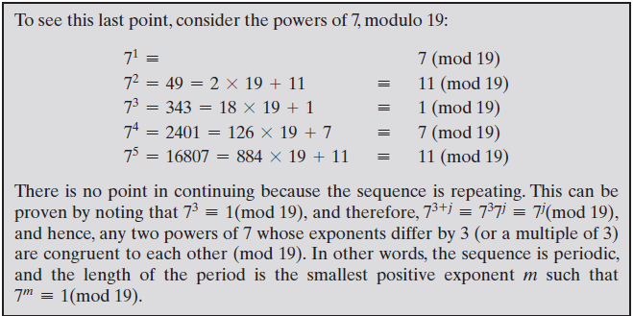
Discrete logarithms
E.g

Slide 46
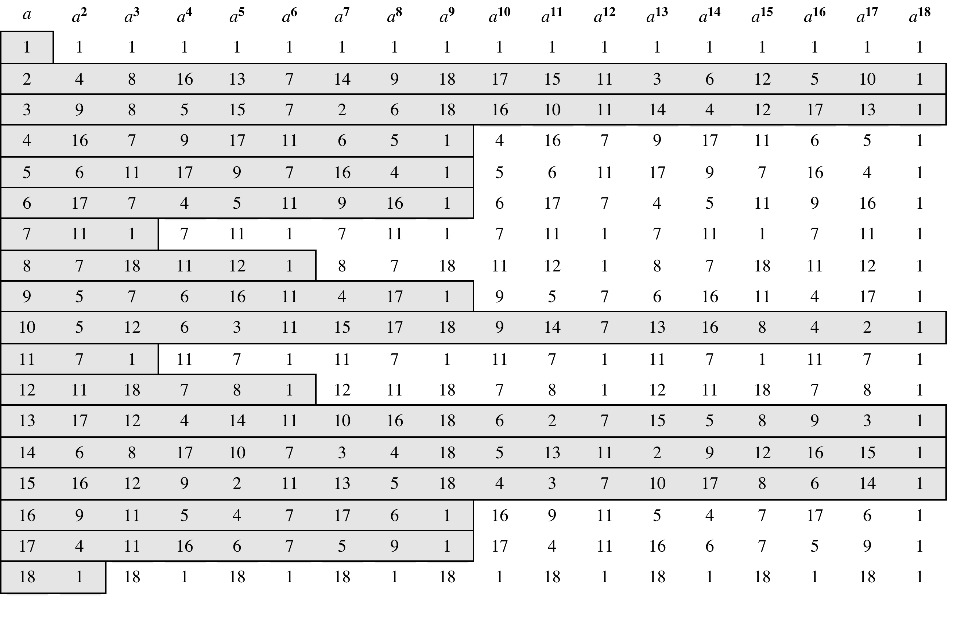
Table 8.3
Powers of Integers, Modulo 19
Notes:
Table 8.3 shows all the powers of a , modulo 19 for all positive ø <19. The
length of the sequence for each base value is indicated by shading. Note the
following:
1. All sequences end in 1. This is consistent with the reasoning of the preceding
few paragraphs.
2. The length of a sequence divides ø (19) = 18. That is, an integral number of
sequences occur in each row of the table.
3. Some of the sequences are of length 18. In this case, it is said that the base
integer a generates (via powers) the set of nonzero integers modulo 19. Each
such integer is called a primitive root of the modulus 19.
More generally, we can say that the highest possible exponent to which a number
can belong (mod n ) is ø (n ). If a number is of this order, it is referred to as a
primitive root of n . The importance of this notion is that if a is a primitive root of n ,
then its powers
a , a² ,. . . , a^{ø(n)}
are distinct (mod n ) and are all relatively prime to n . In particular, for a prime number
p , if a is a primitive root of p , then
a , a² ,. . . , a^{p-1}
are distinct (mod p ). For the prime number 19, its primitive roots are 2, 3, 10, 13, 14,
and 15.
Not all integers have primitive roots. In fact, the only integers with primitive
roots are those of the form 2, 4, pª , and 2pª , where p is any odd prime and a is a
positive integer. The proof is not simple but can be found in many number theory
books, including [ORE76].

Slide 47
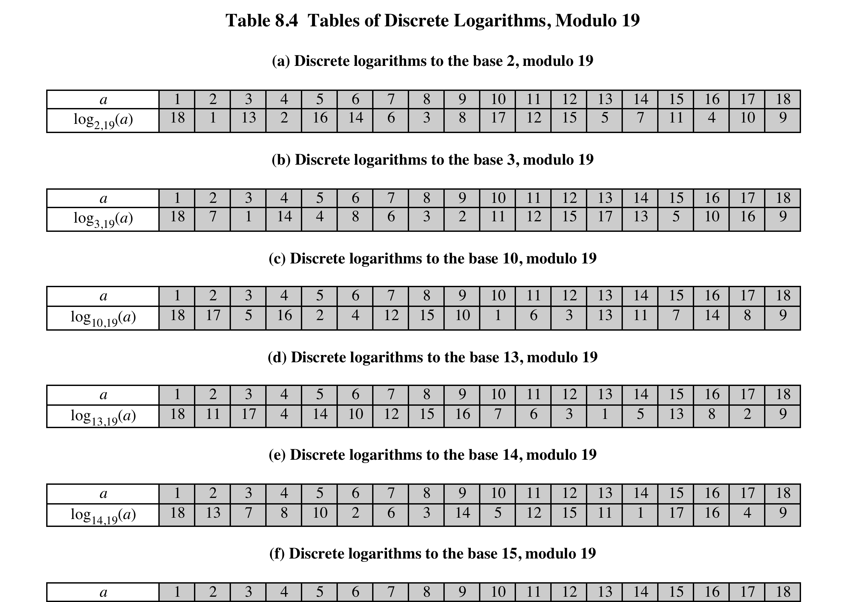
Notes:
Table 8.4, which is directly derived from Table 8.3, shows the sets of discrete
logarithms that can be defined for modulus 19.

Slide 48
Discrete logarithms
Logarithms for Modular Arithmetic
y = x^{logx(y)}

